Slide 1

Metadata and the Rise of Big Data Governance: Active Open Source Initiatives
October 23, 2018

Slide 2

Today’s speakers
John Mertic, Director of Program Management, Linux Foundation
David Radley, ODPi Egeria maintainer, IBM

Slide 3
Today’s reality
Notes:
…lots of tools, lots of audiences…..a variety of silos, each meeting the needs of their “local” constituents…. Some, but not enough integration….and that integration is time consuming, tedious, and more…

Slide 4
Imagine …
An enterprise data catalog that lists all of your data, where it is located, its origin (lineage), owner, structure, meaning, classification and quality
Spanning systems both on premises and within cloud providers
Hosted locally to your data platforms but integrated to provide the enterprise view
Search

Slide 5
Imagine …
New data tools (from any vendor) connect to your data catalog out of the box
No vendor lock-in; nor expensive population of “yet another” proprietary siloed metadata repository
Search

Slide 6
Imagine …
Metadata is added automatically to the catalog as new data is created
Extensible discovery processes characterise and classify the data
Interested parties and processes are notified
Databases
Files
Function
Applications
Function
Functions

Slide 7







Imagine …
Subject matter experts collaborating around the data
Locating the data they need, quickly and efficiently
Feeding back their knowledge about the data and the uses they have made about it to help others and support economic evaluation of data

Slide 8
Imagine …
Automated governance processes protect and manage your data
Metadata-driven access control
Auditing, metering and monitoring
Quality control and exception management
Rights management
Databases

Slide 9
A new manifesto for metadata and governance!
Metadata management must be automated
Metadata management must become ubiquitous
Metadata must become open and remotely accessible
Metadata should be used to drive the governance of data
The discovery, maintenance and use of metadata has to be an integral part of all tools that access, change and move information.
Notes:
The maintenance of metadata must be automated to scale to the sheer volumes and variety of data involved in modern business.
Metadata management must become ubiquitous in cloud platforms and large data platforms, such as Apache Hadoop so that the processing engines on these platforms can rely on its availability and build capability around it.
Metadata access must become open and remotely accessible so that tools from different vendors can work with metadata located on different platforms. This implies unique identifiers for metadata elements, some level of standardization in the types and formats for metadata and standard interfaces for manipulating metadata.
Metadata should be used to drive the governance of data and create a business friendly logical interface to the data landscape.
Wherever possible, discovery and maintenance of metadata has to an integral part of all tools that access, change and move information.

Slide 10
How will this be achieved?
Open and Unified Metadata
Notes:
…lots of tools, lots of audiences…..a variety of silos, each meeting the needs of their “local” constituents…. Some, but not enough integration….and that integration is time consuming, tedious, and more…

Slide 11
Open metadata management ecosystem
Peer-to-peer network of repositories
Metadata stored and managed close to its source
Each repository/tool brings unique value.
Open, extensible metadata structures for metadata exchange and federation
Open source infrastructure sharing cost of development and maintenance
Collaboration
Space Metadata
Cloud SaaS platform Metadata
Analytics Platform Metadata
Application
Metadata
Hadoop Platform Metadata

Slide 12
Making Metadata Available to the Enterprise!
Data Lake
Marketing
Data Lake
Cohort A
Cohort B
Chief Data Office
Systems of Record
Systems of Record
Mobile
Apps

Slide 13
Open metadata data model
Governance
Glossary
Collaboration
Models and
Reference Data
Lineage
Metadata
Discovery
Data Assets
Base Types, Systems
and Infrastructure

Slide 14
Each area caters for appropriate metadata structures
Strategy
4
Subject Area Definition
1
Teaming Metadata
(people profiles, communities, projects,
notebooks, …)
Policy Metadata (Principles, Regulations, Standards, Approaches, Rule Specifications, Roles and Metrics)
Business Objects and Relationships, Taxonomies and Ontologies
Augmentation
3
Organization
Feedback Metadata
(tags, comments, ratings, …)
Rollout
Classification
Business Attributes
Campaigns and Projects
Classification Schemes
Implementation
Mapping
Governance Actions and Processes
Rights
Management
Models and Schemas
2
Asset Collections
(Sets, Typed Sets, Type Organized Sets)
Reference Data
5
Instrument
7
Information Process
Instrumentation (design lineage)
Association
Information Views
Augmentation
Discovery
Metadata (profile data, technical classification, data classification,
data quality assessment, …)
Physical Asset Descriptions
(Data stores, APIs,
models and components)
0
Basic Types, Infrastructure and Systems
Access
6
Connectors

Slide 15
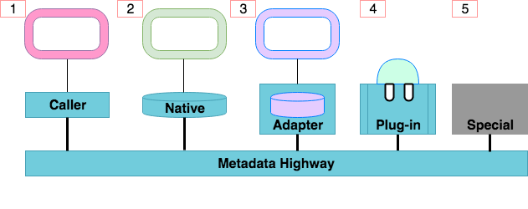
Open metadata and governance integration patterns
Apache Atlas
IBM Information Governance Catalog
Notes:
Caller:
A metadata tool can access the consumer-specific APIs to work with metadata.
The Access Layer handles the calls to metadata repositories connected to the metadata highway
Native
Native implementation of the open metadata governance APIs.
Apache Atlas is a native implementation of the open metadata and governance APIs
Adapter
Simple components plug into a repository proxy to connect in an existing metadata repository.
Plugin:
Connector Framework (OCF)
Connectors to data, analytics etc
Open Discovery Framework (ODF)
Metadata discovery services
Governance action Framework (GAF)
Stewardship services for triage and remediation of exceptions
Special
The tool, engine or data management platform implements its own version of the OMRS and OMASs.
This pattern should only be used if it is impossible to use one of the other patterns.

Slide 16
Business meaning of the underlying assets
Business
metadata
IS-A
Employee
Sensitive
HAS-A
Work Location
HAS-A
HAS-A
Hourly Pay Rate
Manager
Compensation Plan
HAS-A
IS-A
HAS-A
Job Title
IS-A
HAS-A
Employee Id
Annual Salary
Employee Name
Structural
metadata for
a data store
EmpName
EmpNo
JobCode
Salary
Employee Record
Data
00 3809890 6 7 Lemmie Stage 818928 3082 4 New York 4 27 DataStage Expert 1 45324 300 27 Code St Harlem NY 1 3

Slide 17
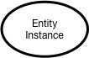
Instance representations in Open Metadata Resource Services (OMRS)

Slide 18
Virtual Data connector – a data virtualization layer example
Search
Out Topic
Data Virtualization
Gaian
Business View
Virtualizer
Information View OMAS
Logical Tables
Technical View
In Topic
Mapping Logic

Slide 19
Open Source Collaboration through ODPi
ODPi is the vendor neutral home for Egeria.
Governance is open to all in the data governance community
Vendors
End-users
Privacy/governance experts
Code is available under an Apache 2.0 license and documentation under a CC-BY-4.0 license
Join the effort at https://github.com/odpi/egeria

Slide 20
How this helps
Data Governance Professionals
Vendors
Your governance program if based on established definitions
Allow a broader range of tools in your organization
Automated governance processes protect and manage your data
Metadata-driven access control
Auditing, metering and monitoring
Quality control and exception management
Rights management
Your metadata offerings will deliver value faster as they tap into metadata collected by other vendor’s tools.
ODPi packages extend your metadata system’s and tools’ capabilities
Conformance tests minimize your effort in being compliant with key standards and regulations.
Customers have increased confidence in your tools and services due to ODPi certification.

Slide 21
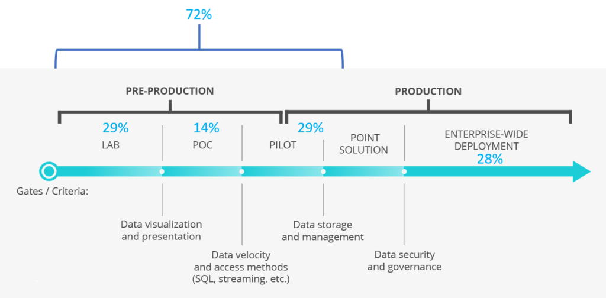
ODPi – A neutral home for collaboration
Notes:
ODPi, a Linux Foundation Project, can provide the platform for industry collaboration on shared technology
In pursuit of its mission to make Apache Hadoop and associated Big Data solutions ready for enterprise-wide deployment, ODPi is focused on the biggest hurdles
In 2016, the largest hurdles were cross-distro harmonization
Today, a key blocker to broad-based production use of Big Data is Governance

Slide 22



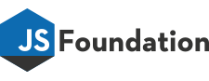

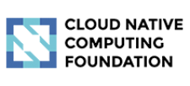



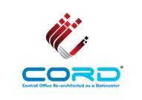
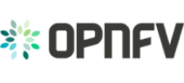



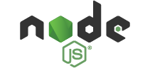
Look to The Linux Foundation
Thankfully, that’s where The Linux Foundation® comes in. For nearly two decades, The Linux Foundation has provided unparalleled support for open source communities through financial and intellectual resources, governance structure, IT infrastructure, services, events, and training.
Dedicated to building sustainable ecosystems around open source projects, The Linux Foundation is working with the global technology community to solve the world’s hardest problems through open source and creating the largest shared technology investment in history.
The Linux Foundation is the umbrella organization for more than 60 open source projects accelerating open technology development and commercial adoption. Some of the game-changing initiatives hosted by The Linux Foundation include:

Slide 23
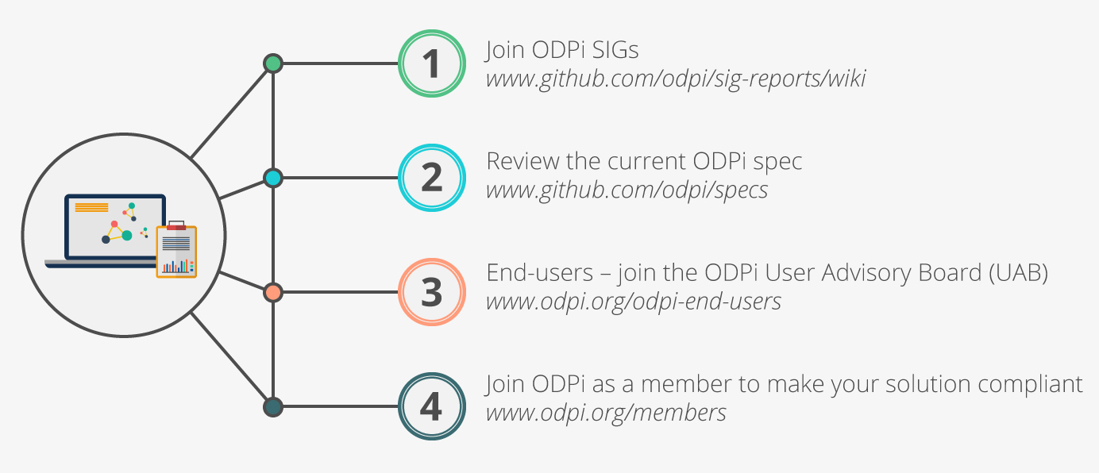
Get involved!
Check out ODPi Data Governance on GitHub
https://github.com/odpi/data-governance
Learn more about Egeria
https://odpi.github.io/egeria/
Follow the discussion
https://lists.odpi.org/g/odpi-pmc-datagovernance
Have your organization support ODPi
https://lists.odpi.org/about/join
Notes:
Mention that individuals can get involved.

Slide 24
z
z
z
z
z
z
z
Questions?

Slide 25


